Slide 1
Chapter 2
Recursion
Objectives
Upon completion you will be able to:
Explain the difference between iteration and recursion
Design a recursive algorithm
Determine when an recursion is an appropriate solution
Write simple recursive functions

Slide 2
2-1 Factorial - A Case Study
We begin the discussion of recursion with a case study and use it to define the concept.
This section also presents an iterative and a recursive solution to the factorial algorithm.
Recursive Defined
Recursive Solution

Slide 3
Writing repetitive algorithms
Iteration
Recursion
  a repetitive process in which an algorithm calls itself.

Slide 4
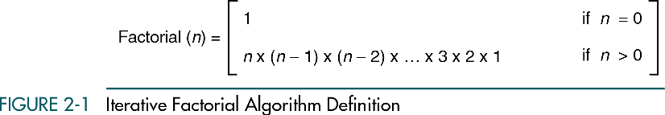
Iterative
The definition involves only the algorithm parameter(s) and not the algorithm itself.

Slide 5
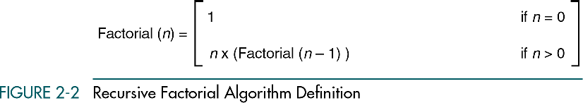
Recursive
A repetitive algorithm uses recursion whenever the algorithm appears within the definition itself.

Slide 6
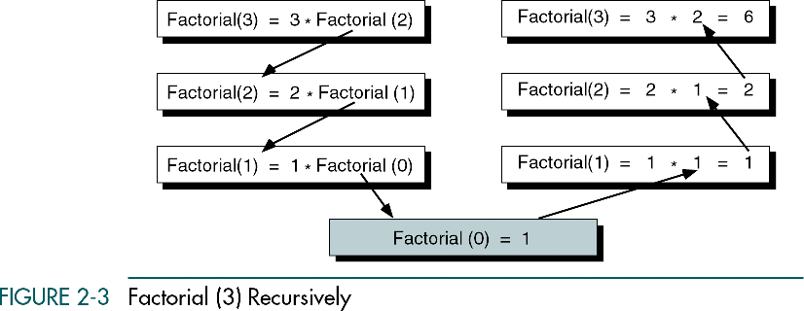

Slide 7
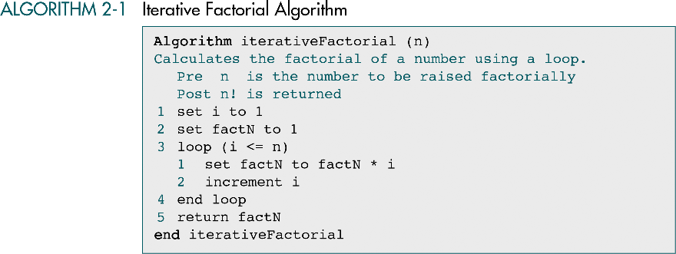

Slide 8
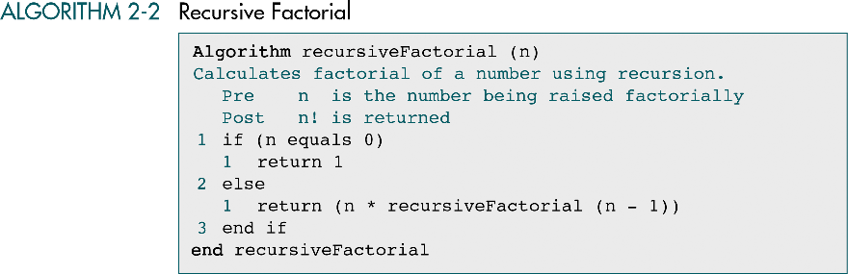

Slide 9
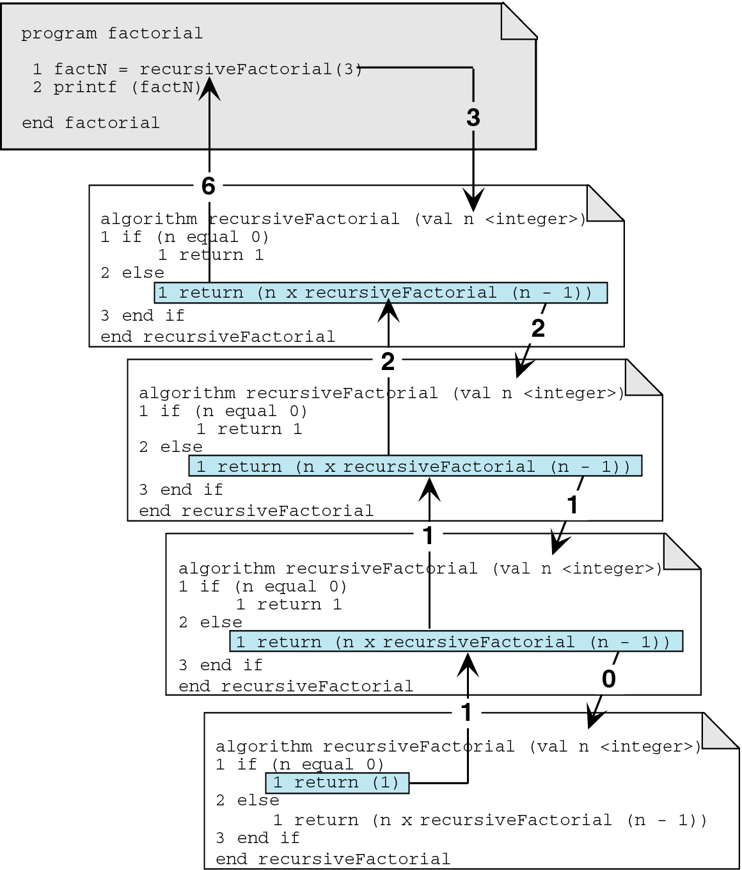
Calling a recursive algorithm

Slide 10
2-2 Designing Recursive Algorithms
In this section we present an analytical approach to designing recursive algorithms.
We also discuss algorithm designs that are not well suited to recursion.
The Design Methodology
Limitation of Recusion
Design Implemenation

Slide 11
The Design Methodology
Every recursive call either solves a part of the problem or it reduce the size of the problem.

Slide 12
The Design Methodology
Base case
  The statement that “solves” the problem.
  Every recursive algorithm must have a base case.
General case
  The rest of the algorithm
  Contains the logic needed to reduce the size of the problem.

Slide 13
Rules for designing a recursive algorithm
Determine the base case.
Determine the general case.
Combine the base case and the general cases into an algorithm.

Slide 14
Combine the base case and the general cases into an algorithm
Each call must reduce the size of the problem and move it toward the base case.
The base case, when reached, must terminate without a call to the recursive algorithms; that is, it must execute a return.

Slide 15
Limitations of recursion
You should not use recursion if the answer to any of the following questions is no:
  Is the algorithm or data structure naturally suited to recursion?
  Is the recursive solution shorter and more understandable?
  Does the recursive solution run within acceptable time and space limits?

Slide 16
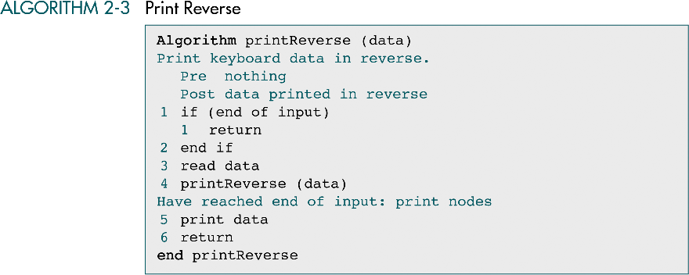

Slide 17
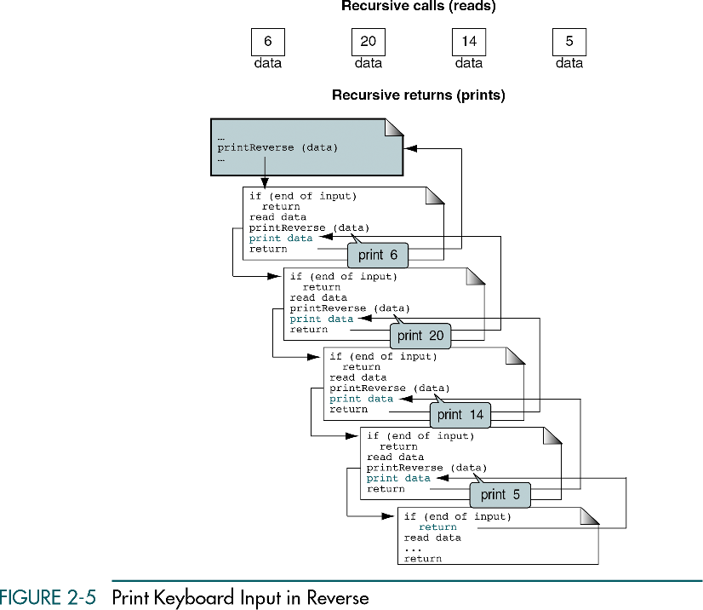
data=6
data=20
data=14
data=5

Slide 18
2-3 Recursive Examples
Four recursive programs are developed and analyzed. Only one, the Towers of Hanoi, turns out to be a good application for recursion.
Greatest Common Divisor
Fiboncci Numbers
Prefix to Postfix Conversion
The Towers of Honoi
Slide 05

Slide 19
Greatest Common Divisor
The greatest common divisor for 10 and 25 is 5.

Slide 20
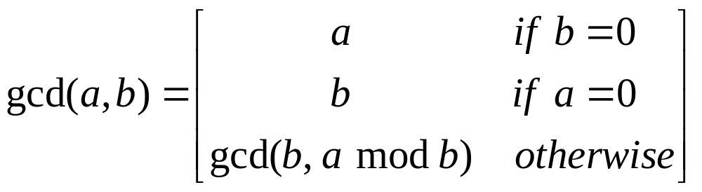
Greatest Common Divisor
Greatest Common Divisor Recursive Definition

Slide 21
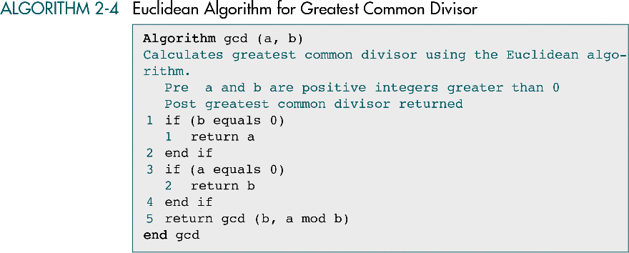

Slide 22
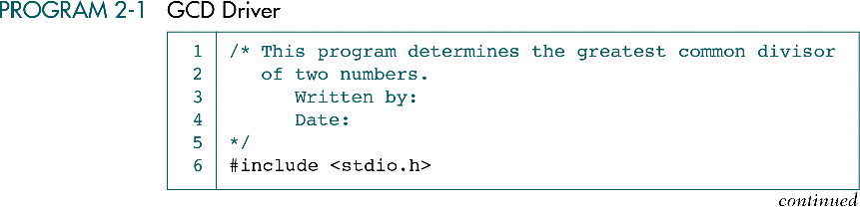

Slide 23
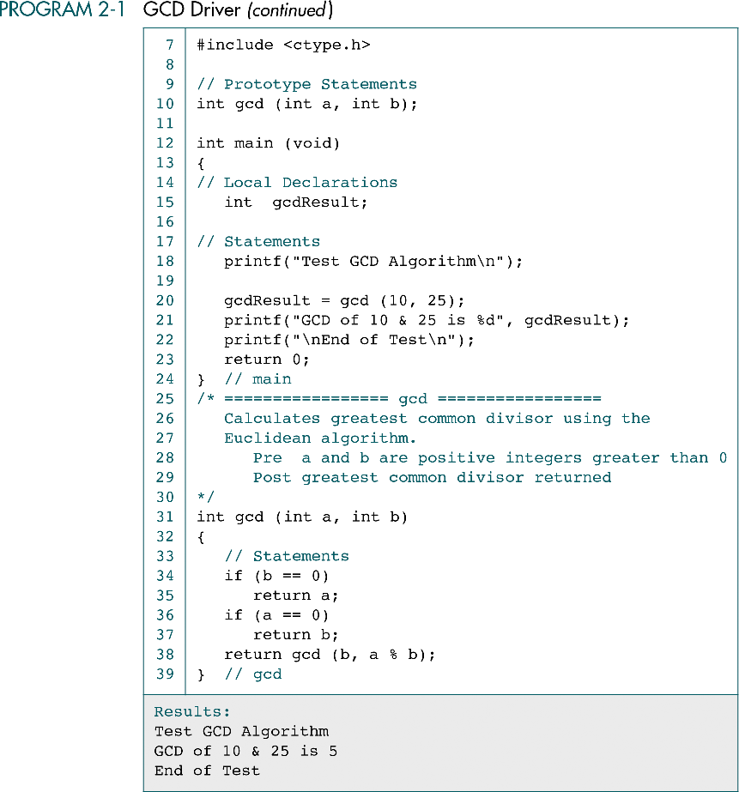

Slide 24
gcd(10, 25)
gcd(25, 10)
gcd(10, 5)
gcd(5, 0)

Slide 25
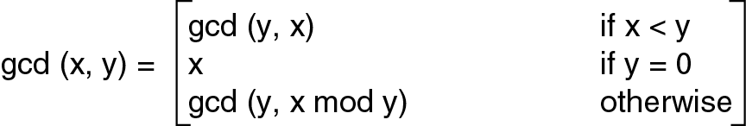
Another G.C.D. Recursive Definition

Slide 26
Fibonacci numbers
Each number is the sum of the previous two numbers.
The first few numbers in the Fibonacci series are
  0, 1, 1, 2, 3, 5, 8, 13, 21, 34, …

Slide 27
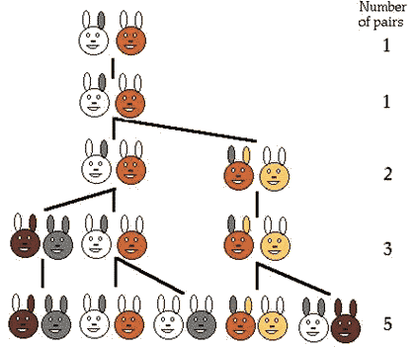
Fibonacci numbers

Slide 28
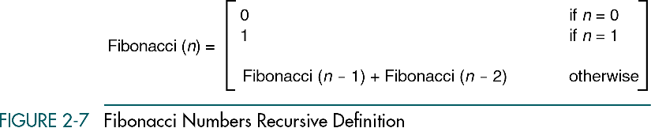

Slide 29
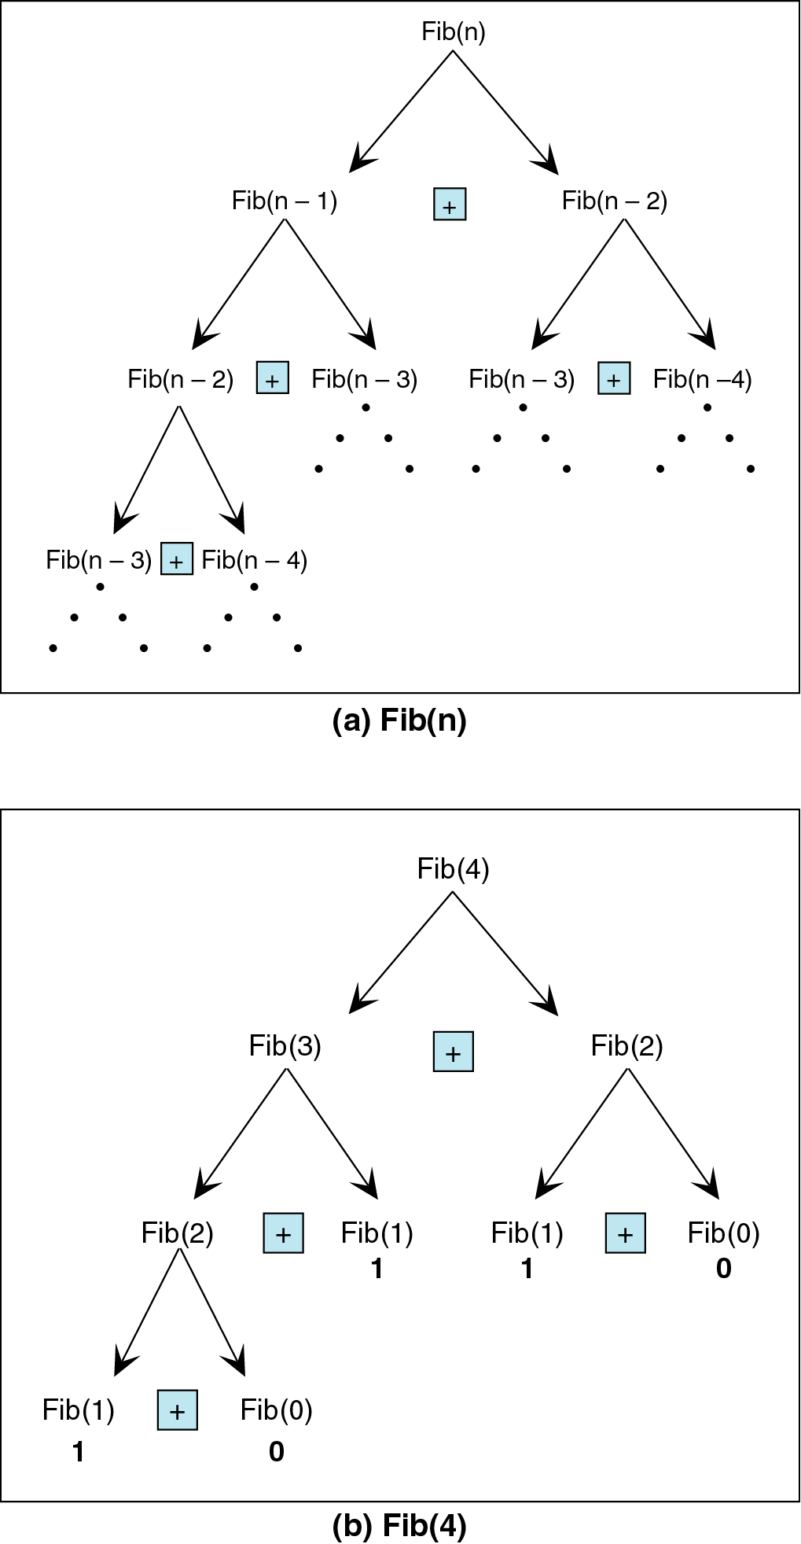

Slide 31
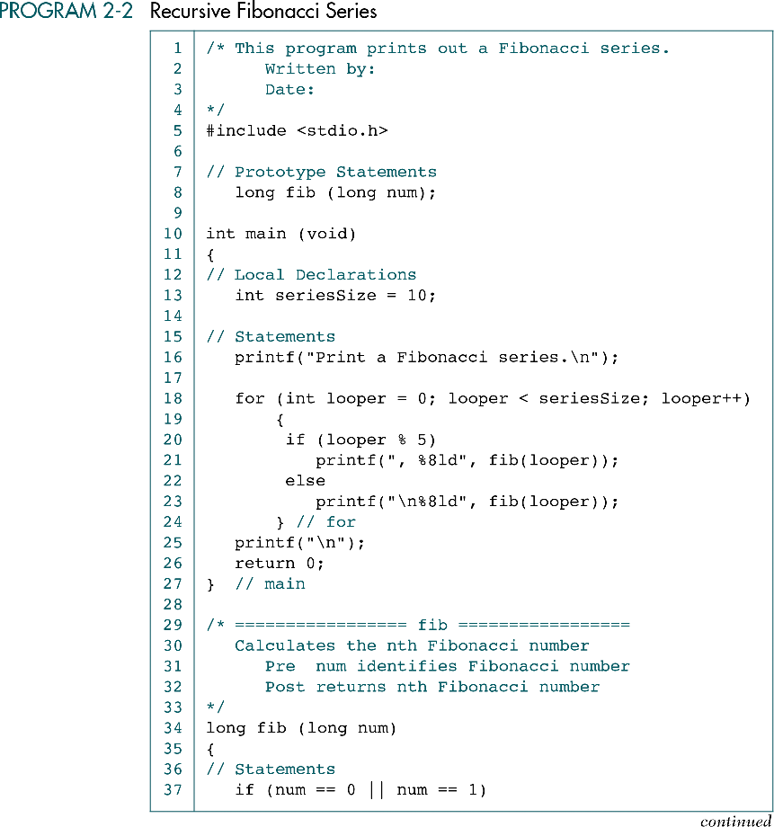

Slide 32
(Continued)
0 represents .T.

Slide 33
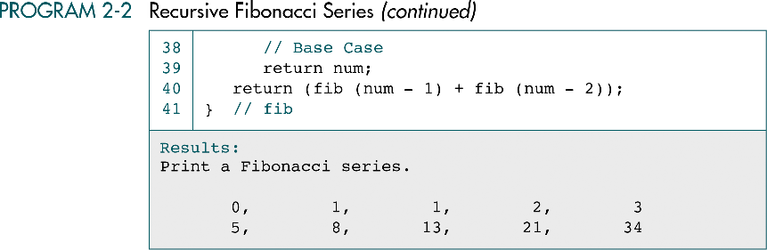

Slide 34
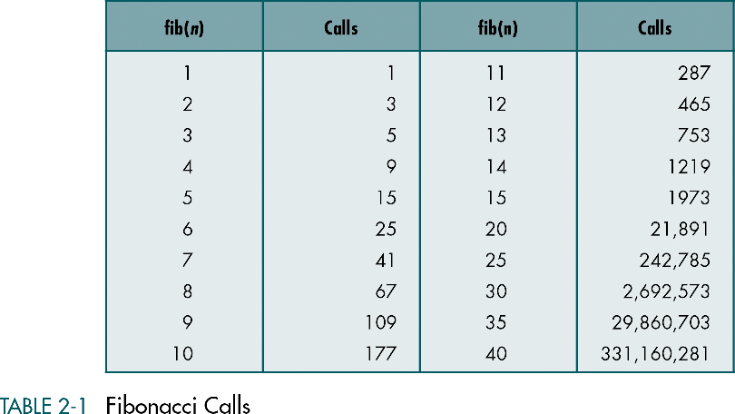
Not a good solution for large n

Slide 35
Infix, Postfix and Prefix
Infix notation: X + Y
  Operators are written infix-style between their operands. This is the usual way we write expressions.
  An expression such as
  A * ( B + C ) / D
  is usually taken to mean something like:
  "First add B and C together, then multiply the result by A, then divide by D to give the final answer."

Slide 36
Infix, Postfix and Prefix
Postfix notation (also known as "Reverse Polish notation"): X Y +
  Operators are written after their operands.
  An expression such as
  A * ( B + C ) / D (infix)
  is equivalent to
  A B C + * D / (postfix)
  ( (A (B C +) *) D /) (clearer postfix)

Slide 37
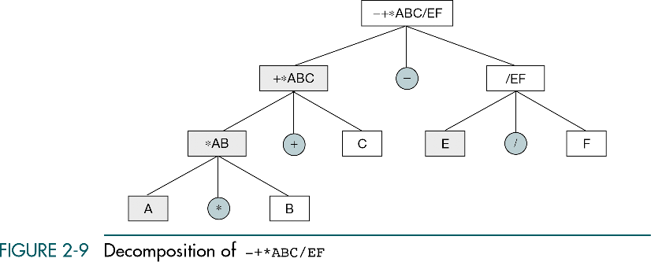

Slide 38
Infix, Postfix and Prefix
Prefix notation (also known as "Polish notation"): + X Y
  Operators are written before their operands.
  An expression such as
  A * ( B + C ) / D (infix)
  is equivalent to
  / * A + B C D (prefix)
  (/ (* A (+ B C) ) D) (clearer prefix)

Slide 39
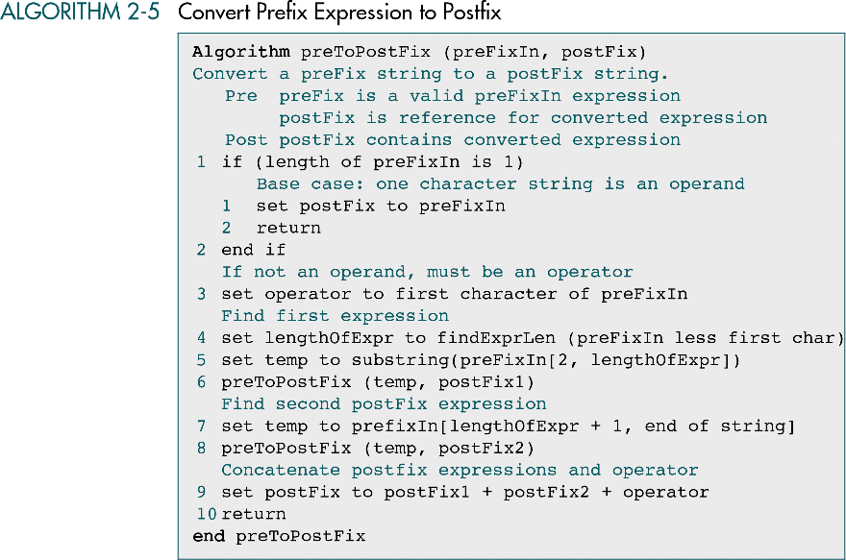

Slide 40
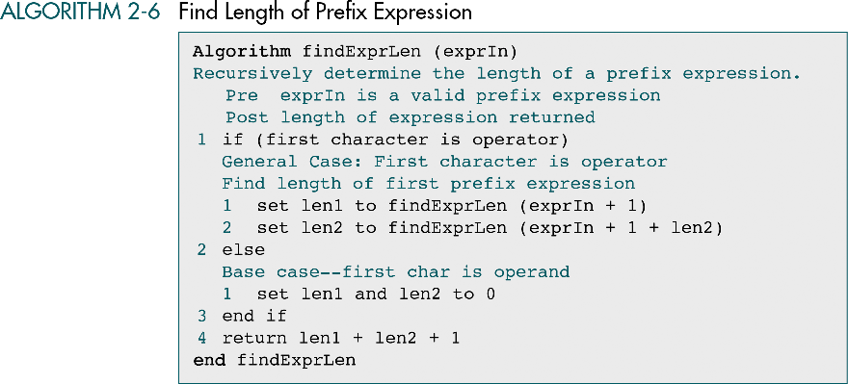

Slide 41
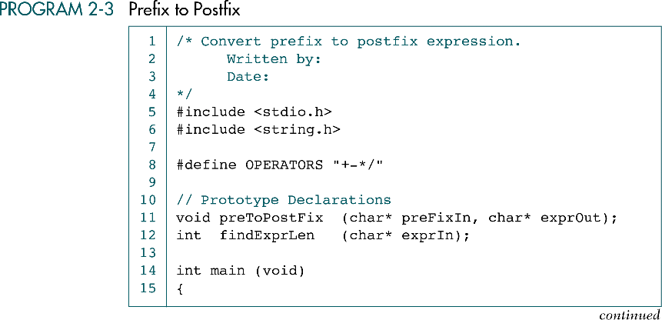

Slide 42
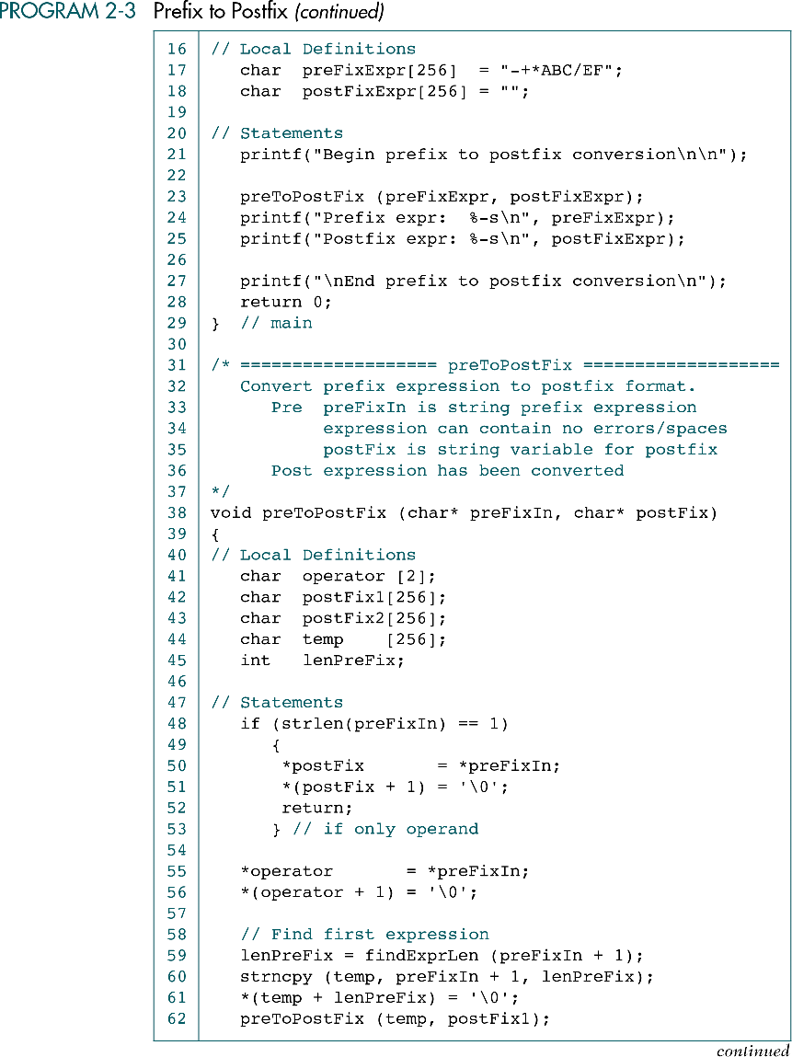

Slide 45
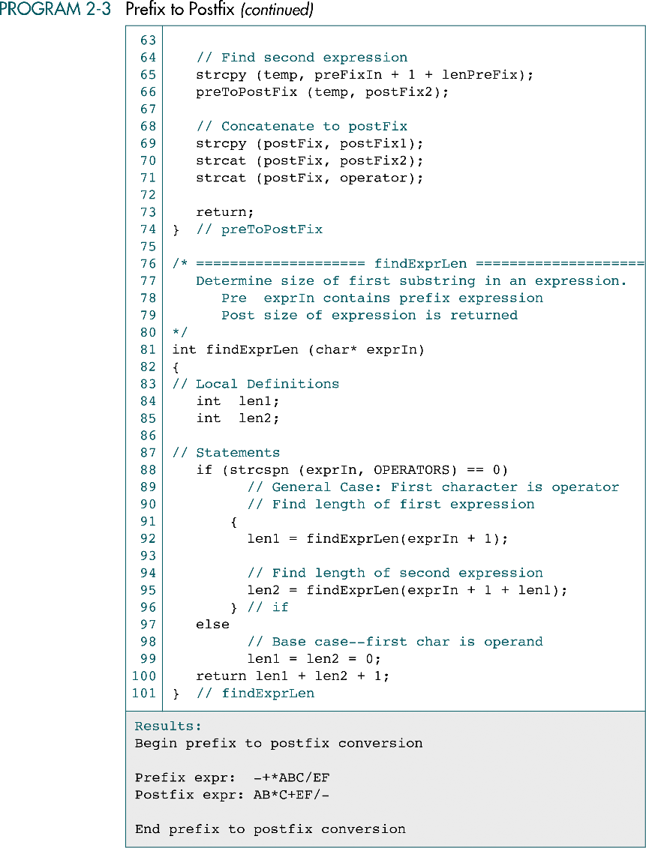

Slide 48
Towers of Hanoi
The Tower of Hanoi or Towers of Hanoi is a mathematical game or puzzle. It consists of three pegs, and a number of disks of different sizes which can slide onto any peg. The puzzle starts with the disks neatly stacked in order of size on one peg, smallest at the top, thus making a conical shape.

Slide 49
Towers of Hanoi
The objective of the game is to move the entire stack to another peg, obeying the following rules:
  Only one disk may be moved at a time.
  Each move consists of taking the upper disk from one of the pegs and sliding it onto another peg, on top of the other disks that may already be present on that peg.
  No disk may be placed on top of a smaller disk.

Slide 50
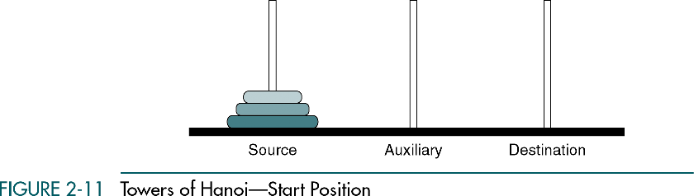

Slide 51
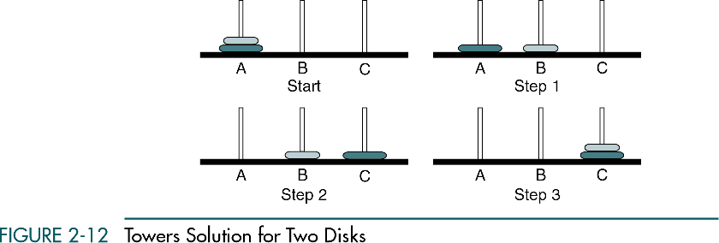

Slide 52


Slide 53
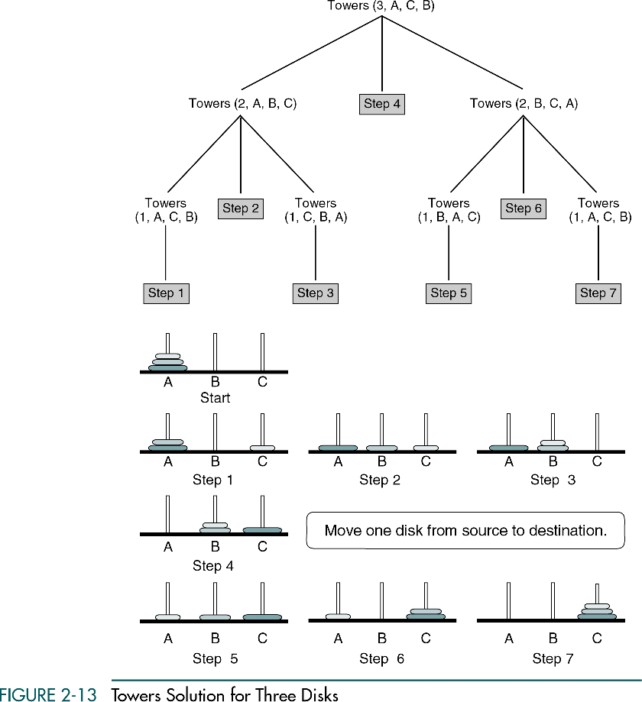

Slide 54
(Continued)

Slide 55
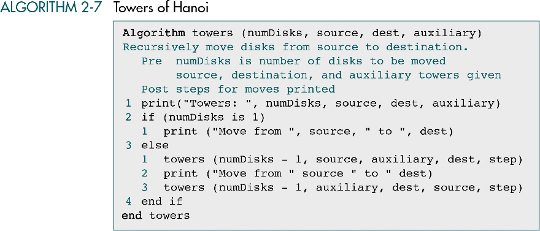

Slide 56
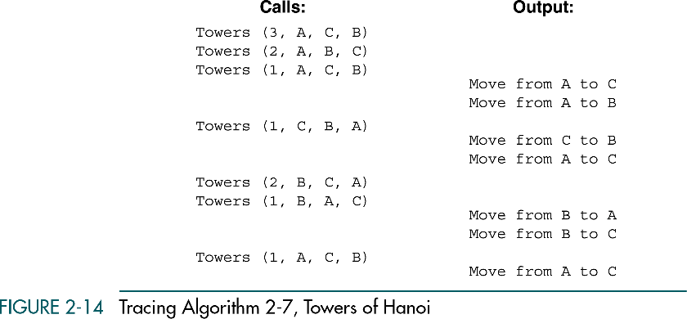

Slide 57
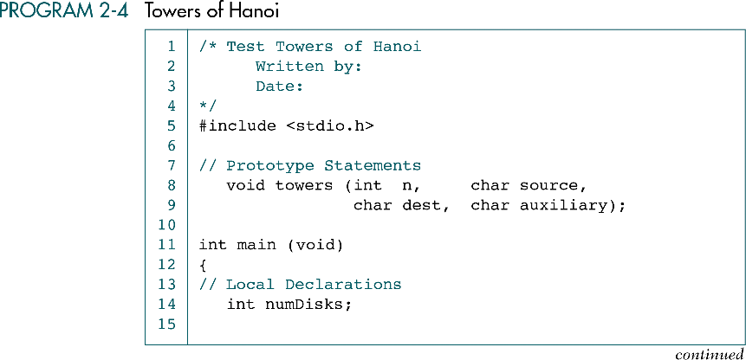

Slide 58
